Slide 1







Take Your Sitecore Project To The Next Level With Node.js
Presented by Anastasiya Flynn,
Sitecore Architect at
@AnastasiyaFlynn

Slide 2
Agenda
This presentation will cover common tasks that Sitecore architects and developers encounter in projects, and I will show you how to leverage server-side JavaScript to solve these tasks.
Setup
Testing
Development
@AnastasiyaFlynn

Slide 3
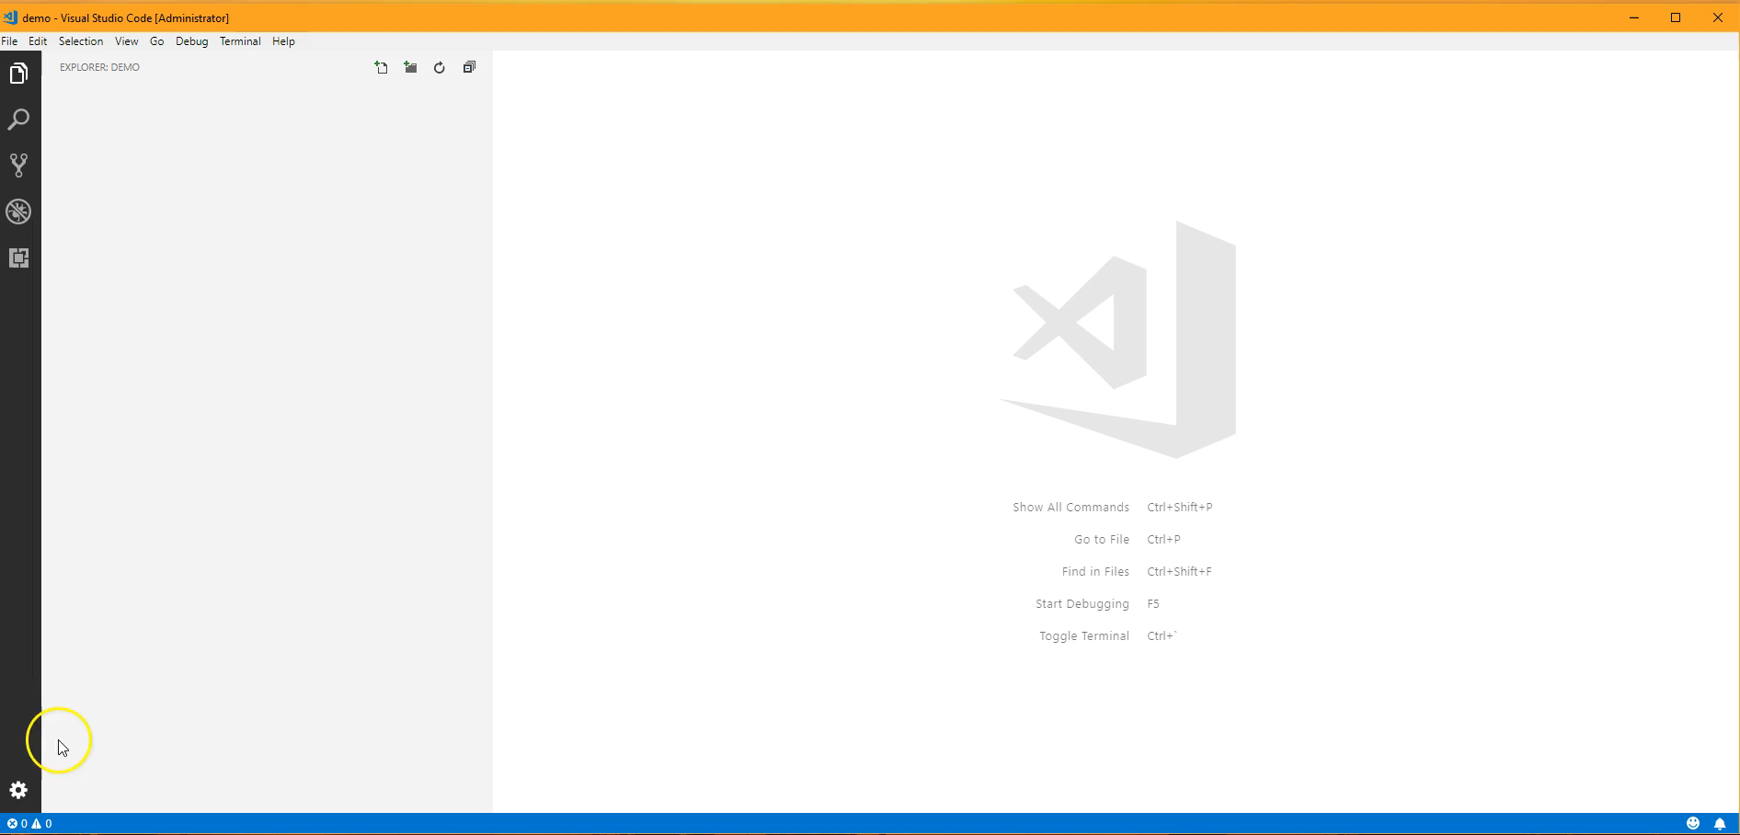
Demo – Creating a Node Module
@AnastasiyaFlynn

Slide 4
Setup
Automate the setup of a complex Sitecore project with Yeoman
Setup
Testing
Development
@AnastasiyaFlynn

Slide 5
New Solution Checklist
C# Projects
Helix structure
Sitecore NuGet references
Build profiles
Unit tests
TDS Projects
Helix structure
Validation rules
Package generation
Glass models generation
Assembly inclusion
Code Style
Resharper inspection rules
Stylecop configuration
EditorConfig file
TypeScript Library
Headless build
Bundling/ minification
Transpilation to ES5
Unit Tests/ Runner
Linting
Front-End Assets
Sass Compilation
Linting
Bundling/ minification
DevOps
Gulpfile
Node dependencies
@AnastasiyaFlynn

Slide 6

New Solution Checklist
Create C# projects
Find correct Sitecore NuGets
Add TDS projects
Set up package generation
How do we build Sass and JS again?
Let’s just build it
YSOD
Coffee
Set up build profiles
Is my target framework right?
Repeat for other Helix layers
@AnastasiyaFlynn

Slide 7

Automate Project Setup With Yeoman
http://yeoman.io/
“Yeoman is a generic scaffolding system... Yeoman by itself doesn’t make any decisions. Every decision is made by generators.”
App
Sub Module
Sub Module
@AnastasiyaFlynn
© 2001-2018 Sitecore Corporation A/S. All rights reserved. Sitecore® and Own the Experience® are registered trademarks of Sitecore Corporation A/S. All other brand and product names are the property of their respective owners.

Slide 8
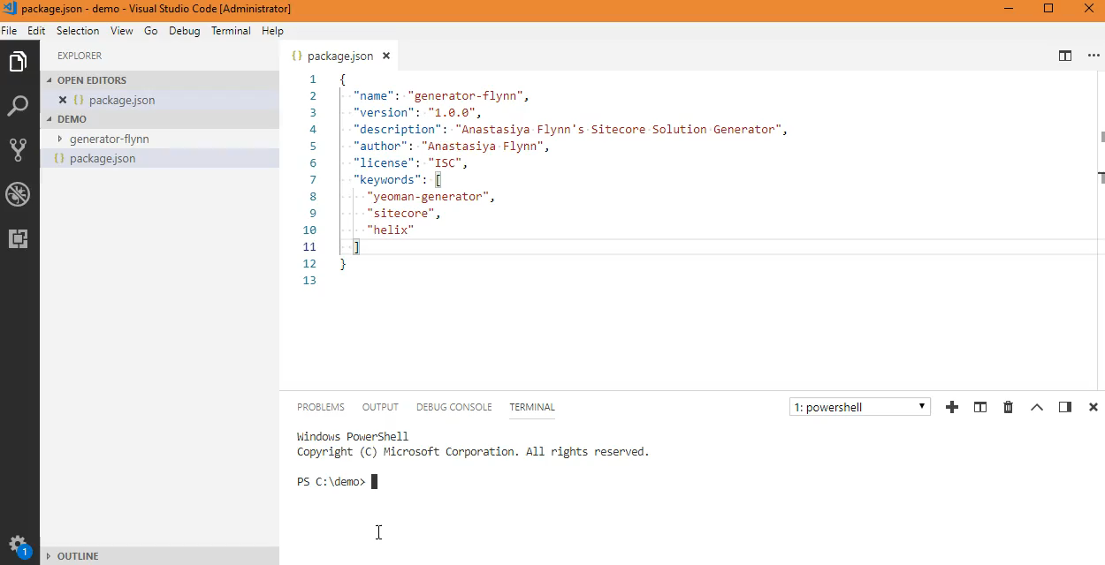
Yeoman Generator – Setting Up
@AnastasiyaFlynn
© 2001-2018 Sitecore Corporation A/S. All rights reserved. Sitecore® and Own the Experience® are registered trademarks of Sitecore Corporation A/S. All other brand and product names are the property of their respective owners.

Slide 9
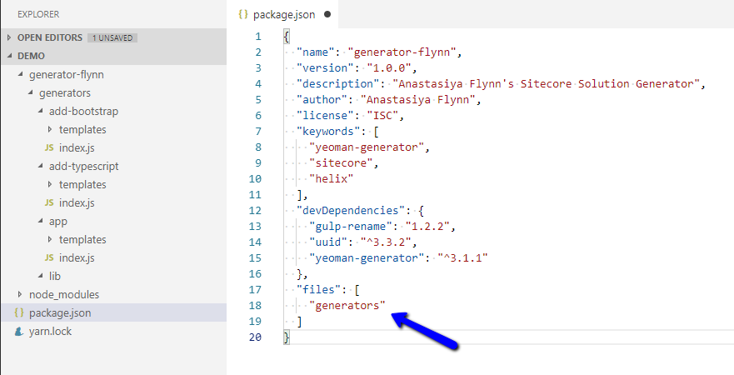
Yeoman – Setting Up
/package.json
app
add-bootstrap
add-typescript
@AnastasiyaFlynn
© 2001-2018 Sitecore Corporation A/S. All rights reserved. Sitecore® and Own the Experience® are registered trademarks of Sitecore Corporation A/S. All other brand and product names are the property of their respective owners.

Slide 10
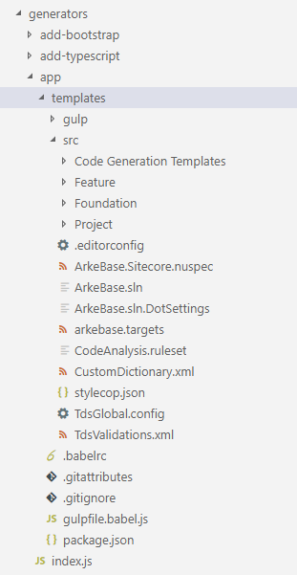
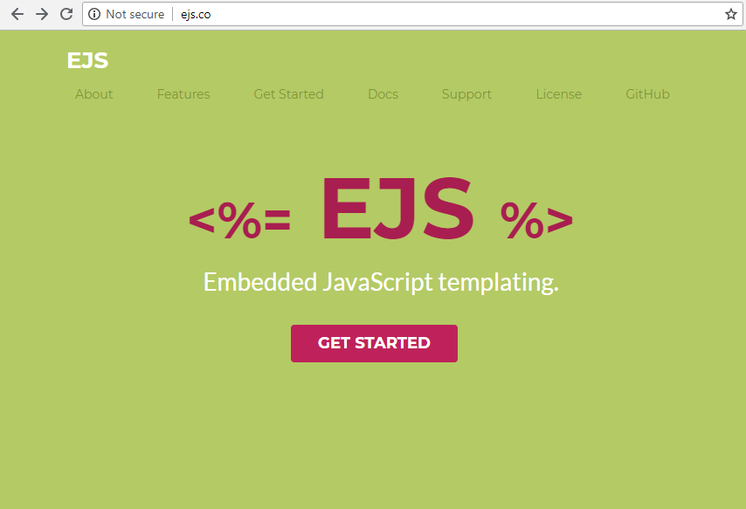
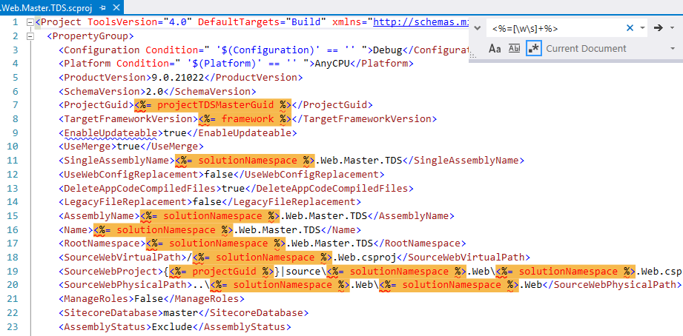
Yeoman – Template Variables
Solution name
Solution namespace
MVC area name
Local Sitecore URL
Sitecore version
.NET framework
@AnastasiyaFlynn
© 2001-2018 Sitecore Corporation A/S. All rights reserved. Sitecore® and Own the Experience® are registered trademarks of Sitecore Corporation A/S. All other brand and product names are the property of their respective owners.

Slide 11
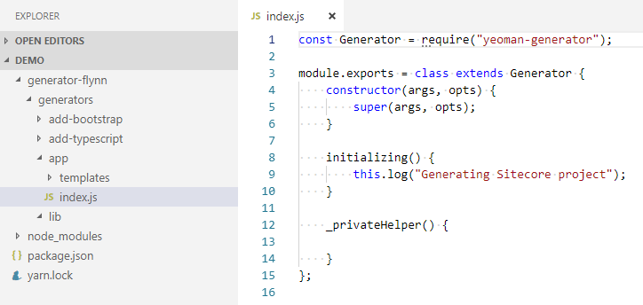
Yeoman – Generator Lifecycle
/generators/app/index.js
Initializing
Prompting
Configuring
Writing
Install
End
Default
Conflicts
@AnastasiyaFlynn
© 2001-2018 Sitecore Corporation A/S. All rights reserved. Sitecore® and Own the Experience® are registered trademarks of Sitecore Corporation A/S. All other brand and product names are the property of their respective owners.

Slide 12
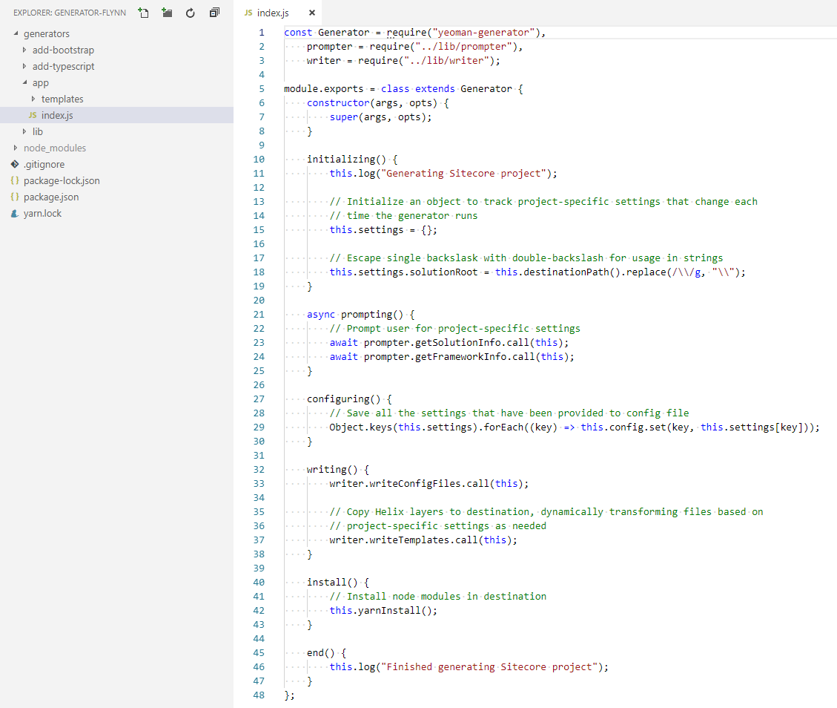
/generators/app/index.js
Initializing
Log Message
Prompting
Prompt user for project-specific settings
Configuring
Save all the settings that have been provided to config file
Writing
Install
End
Log Message
Initialize settings object
Write settings to config file on disk
Copy templates to destination, transforming content using project-specific settings
Install node modules in destination
@AnastasiyaFlynn
© 2001-2018 Sitecore Corporation A/S. All rights reserved. Sitecore® and Own the Experience® are registered trademarks of Sitecore Corporation A/S. All other brand and product names are the property of their respective owners.

Slide 13
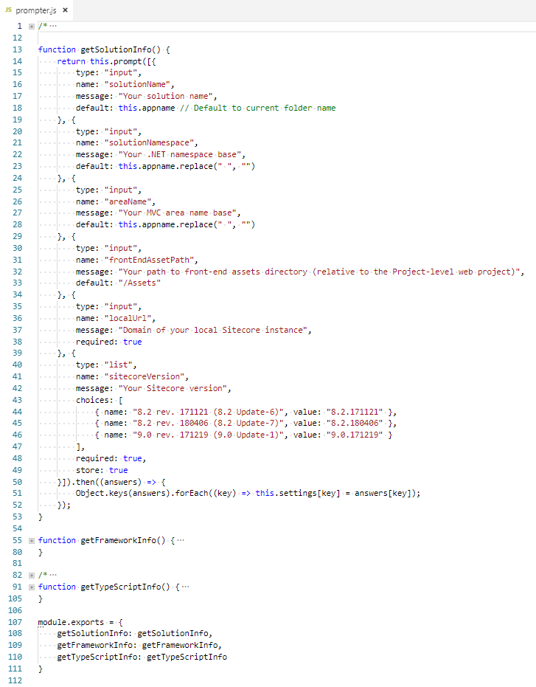
/generators/app/index.js
/generators/lib/prompter.js
@AnastasiyaFlynn
© 2001-2018 Sitecore Corporation A/S. All rights reserved. Sitecore® and Own the Experience® are registered trademarks of Sitecore Corporation A/S. All other brand and product names are the property of their respective owners.

Slide 14
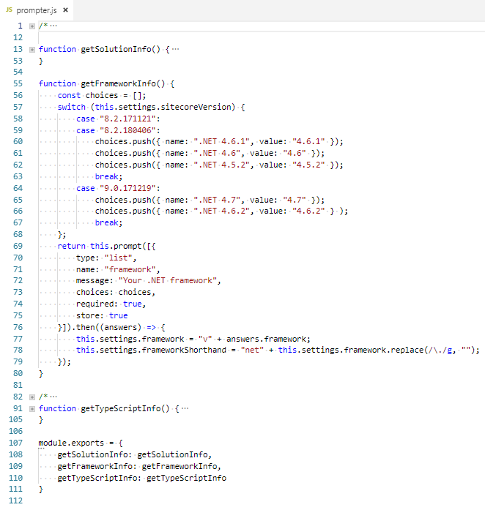
/generators/app/index.js
/generators/lib/prompter.js
@AnastasiyaFlynn
© 2001-2018 Sitecore Corporation A/S. All rights reserved. Sitecore® and Own the Experience® are registered trademarks of Sitecore Corporation A/S. All other brand and product names are the property of their respective owners.

Slide 15
/generators/app/index.js
Initializing
Log Message
Prompting
Prompt user for project-specific settings
Configuring
Save all the settings that have been provided to config file
Writing
Install
End
Log Message
Initialize settings object
Write settings to config file on disk
Copy templates to destination, transforming content using project-specific settings
Install node modules in destination
@AnastasiyaFlynn
© 2001-2018 Sitecore Corporation A/S. All rights reserved. Sitecore® and Own the Experience® are registered trademarks of Sitecore Corporation A/S. All other brand and product names are the property of their respective owners.

Slide 16
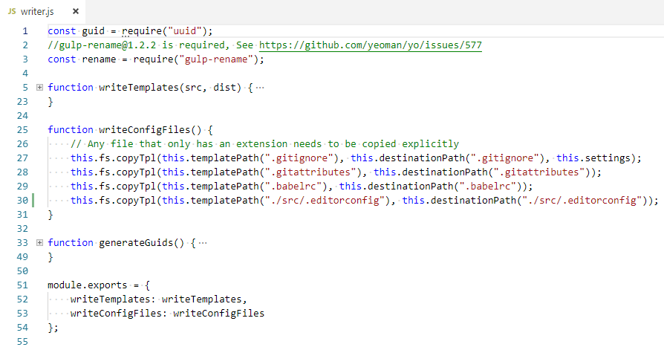
/generators/app/index.js
/generators/lib/writer.js
@AnastasiyaFlynn
© 2001-2018 Sitecore Corporation A/S. All rights reserved. Sitecore® and Own the Experience® are registered trademarks of Sitecore Corporation A/S. All other brand and product names are the property of their respective owners.

Slide 17
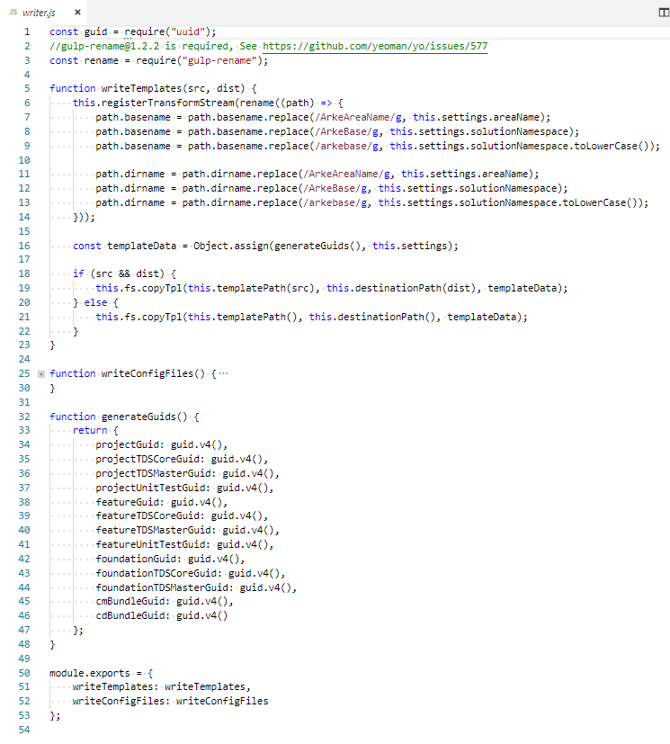
/generators/app/index.js
/generators/lib/writer.js
@AnastasiyaFlynn
© 2001-2018 Sitecore Corporation A/S. All rights reserved. Sitecore® and Own the Experience® are registered trademarks of Sitecore Corporation A/S. All other brand and product names are the property of their respective owners.

Slide 18
/generators/app/index.js
Initializing
Log Message
Prompting
Prompt user for project-specific settings
Configuring
Save all the settings that have been provided to config file
Writing
Install
End
Log Message
Initialize settings object
Write settings to config file on disk
Copy templates to destination, transforming content using project-specific settings
Install node modules in destination
@AnastasiyaFlynn
© 2001-2018 Sitecore Corporation A/S. All rights reserved. Sitecore® and Own the Experience® are registered trademarks of Sitecore Corporation A/S. All other brand and product names are the property of their respective owners.

Slide 19
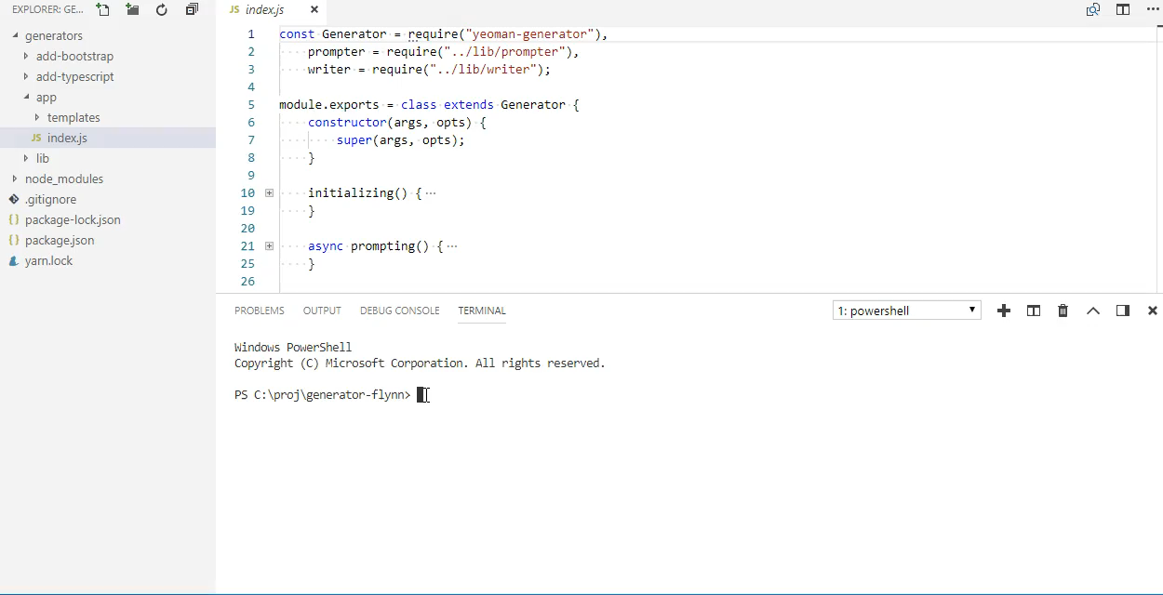
Yeoman – Exposing Generator For Testing
@AnastasiyaFlynn
© 2001-2018 Sitecore Corporation A/S. All rights reserved. Sitecore® and Own the Experience® are registered trademarks of Sitecore Corporation A/S. All other brand and product names are the property of their respective owners.

Slide 20
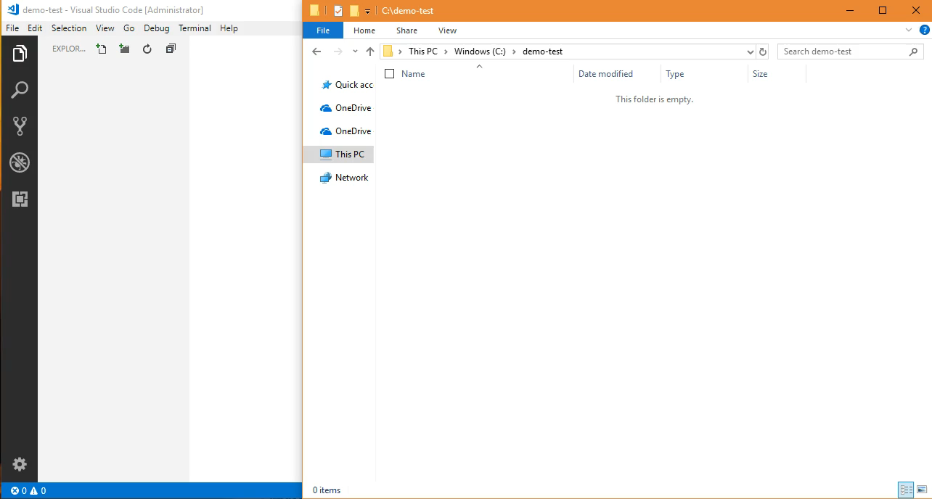
Yeoman – Running Main Generator
@AnastasiyaFlynn
© 2001-2018 Sitecore Corporation A/S. All rights reserved. Sitecore® and Own the Experience® are registered trademarks of Sitecore Corporation A/S. All other brand and product names are the property of their respective owners.

Slide 21
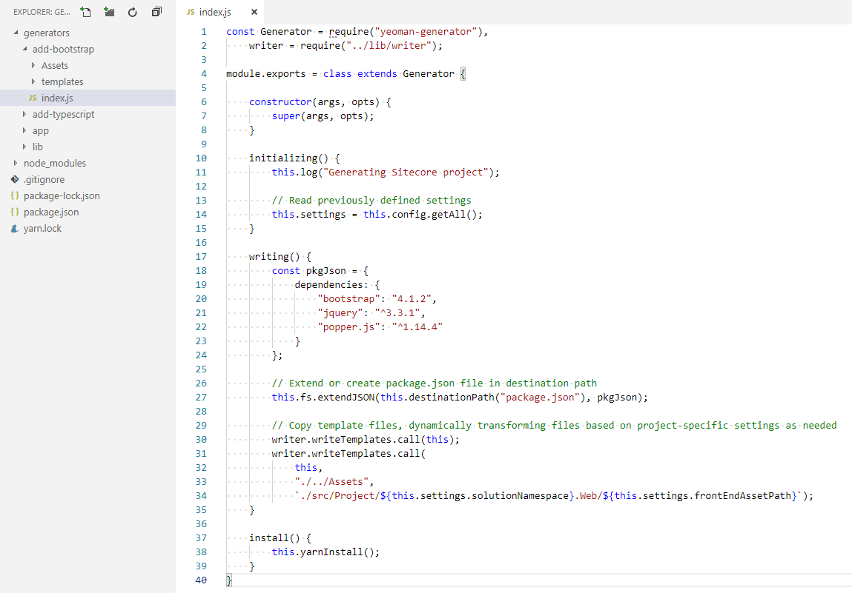
/generators/add-bootstrap/index.js
Initializing
Log Message
Writing
Install
Read previously defined settings
Copy templates to destination, transforming content using project-specific settings
Install new Node module dependencies
Update Node module dependency declarations
@AnastasiyaFlynn
© 2001-2018 Sitecore Corporation A/S. All rights reserved. Sitecore® and Own the Experience® are registered trademarks of Sitecore Corporation A/S. All other brand and product names are the property of their respective owners.

Slide 22
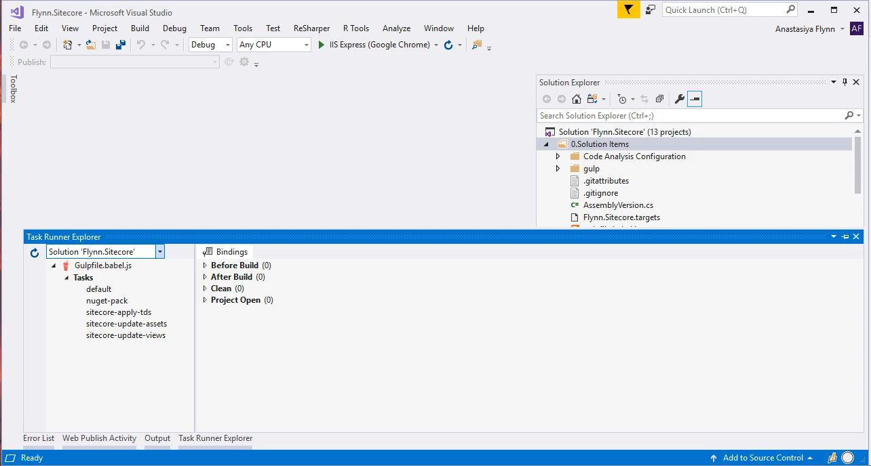
Yeoman – Running Sub-Generator
@AnastasiyaFlynn
© 2001-2018 Sitecore Corporation A/S. All rights reserved. Sitecore® and Own the Experience® are registered trademarks of Sitecore Corporation A/S. All other brand and product names are the property of their respective owners.

Slide 23
New Solution Checklist – Conquered!
C# Projects
Helix structure
Sitecore NuGet references
Build profiles
Unit tests
TDS Projects
Helix structure
Validation rules
Package generation
Glass models generation
Assembly inclusion
Code Style
Resharper inspection rules
Stylecop configuration
EditorConfig file
TypeScript Library
Headless build
Bundling/ minification
Transpilation to ES5
Unit Tests/ Runner
Linting
Front-End Assets
Sass Compilation
Linting
Bundling/ minification
DevOps
Gulpfile
Node dependencies
@AnastasiyaFlynn

Slide 24
Development
Use Webpack to
Helix-ify the JavaScript layer
Build against a headless CMS
Perform on-the-fly compilation
Setup
Testing
Development
@AnastasiyaFlynn

Slide 25
TypeScript Helix
Foundation (C#)
Feature (C#)
Project (C#)
JavaScript/TypeScript Library
Project
Feature
Foundation
@AnastasiyaFlynn
© 2001-2018 Sitecore Corporation A/S. All rights reserved. Sitecore® and Own the Experience® are registered trademarks of Sitecore Corporation A/S. All other brand and product names are the property of their respective owners.

Slide 26
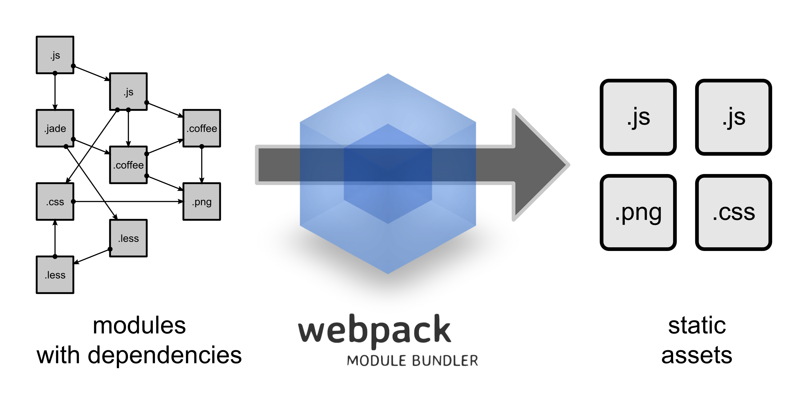
What is Webpack?
https://webpack.js.org/
@AnastasiyaFlynn
© 2001-2018 Sitecore Corporation A/S. All rights reserved. Sitecore® and Own the Experience® are registered trademarks of Sitecore Corporation A/S. All other brand and product names are the property of their respective owners.

Slide 27
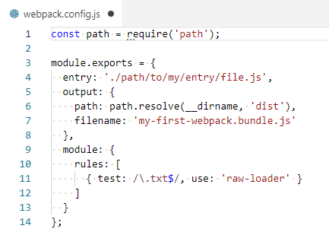
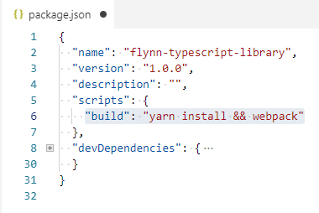
Webpack - Configuration
> yarn add webpack --dev
> yarn add webpack-cli --dev
/webpack.config.json
/package.json
@AnastasiyaFlynn
© 2001-2018 Sitecore Corporation A/S. All rights reserved. Sitecore® and Own the Experience® are registered trademarks of Sitecore Corporation A/S. All other brand and product names are the property of their respective owners.

Slide 28
TypeScript Helix
Foundation
Feature
Project
Group - Common
Group - Product
Gallery
Carousel
Add To Cart
Customer Reviews
Related Products
Component Factory
Event Manager
Global Context
Shared Utilities
@AnastasiyaFlynn
© 2001-2018 Sitecore Corporation A/S. All rights reserved. Sitecore® and Own the Experience® are registered trademarks of Sitecore Corporation A/S. All other brand and product names are the property of their respective owners.

Slide 29
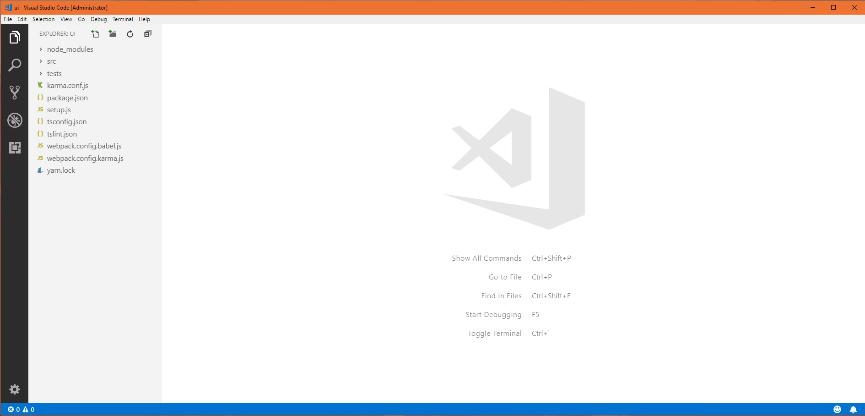
Webpack – Demo ‘npm run build’
@AnastasiyaFlynn
© 2001-2018 Sitecore Corporation A/S. All rights reserved. Sitecore® and Own the Experience® are registered trademarks of Sitecore Corporation A/S. All other brand and product names are the property of their respective owners.

Slide 30
TypeScript Helix
Foundation
Feature
Project
/html
/json
/css
/images
Group - Common
Group - Product
Gallery
Carousel
Add To Cart
Customer Reviews
Related Products
Component Factory
Event Manager
Global Context
Shared Utilities
@AnastasiyaFlynn
© 2001-2018 Sitecore Corporation A/S. All rights reserved. Sitecore® and Own the Experience® are registered trademarks of Sitecore Corporation A/S. All other brand and product names are the property of their respective owners.

Slide 31
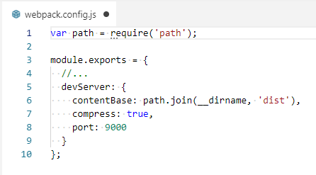
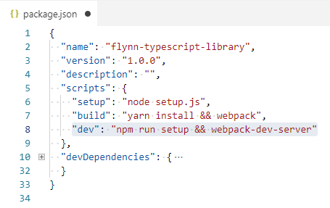
Webpack Dev Server - Configuration
https://webpack.js.org/configuration/dev-server/
> yarn add webpack-dev-server --dev
/webpack.config.json
/package.json
@AnastasiyaFlynn
© 2001-2018 Sitecore Corporation A/S. All rights reserved. Sitecore® and Own the Experience® are registered trademarks of Sitecore Corporation A/S. All other brand and product names are the property of their respective owners.

Slide 32
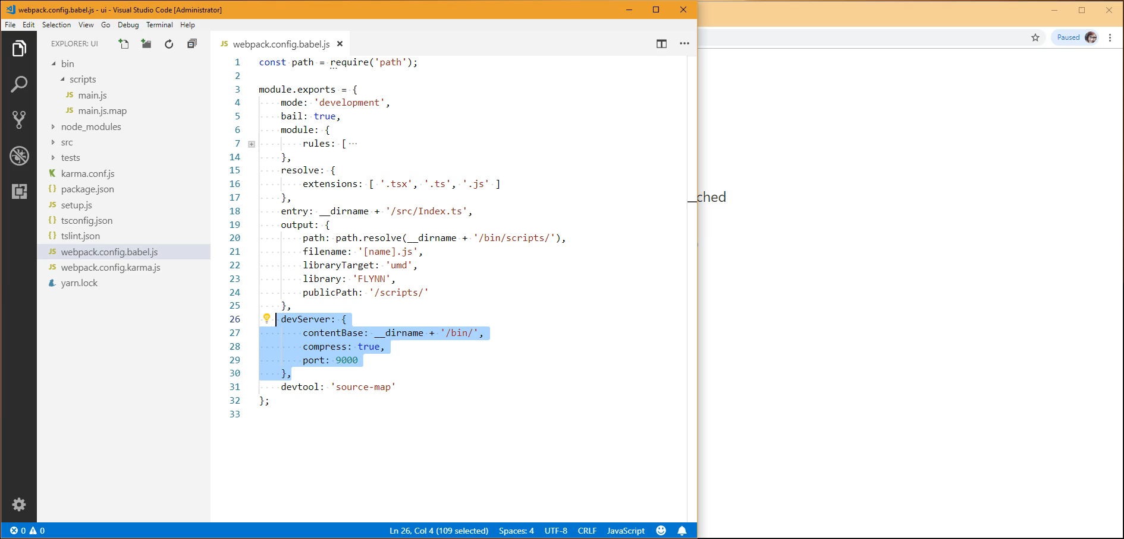
Webpack – Demo ‘npm run dev’
@AnastasiyaFlynn
© 2001-2018 Sitecore Corporation A/S. All rights reserved. Sitecore® and Own the Experience® are registered trademarks of Sitecore Corporation A/S. All other brand and product names are the property of their respective owners.

Slide 33
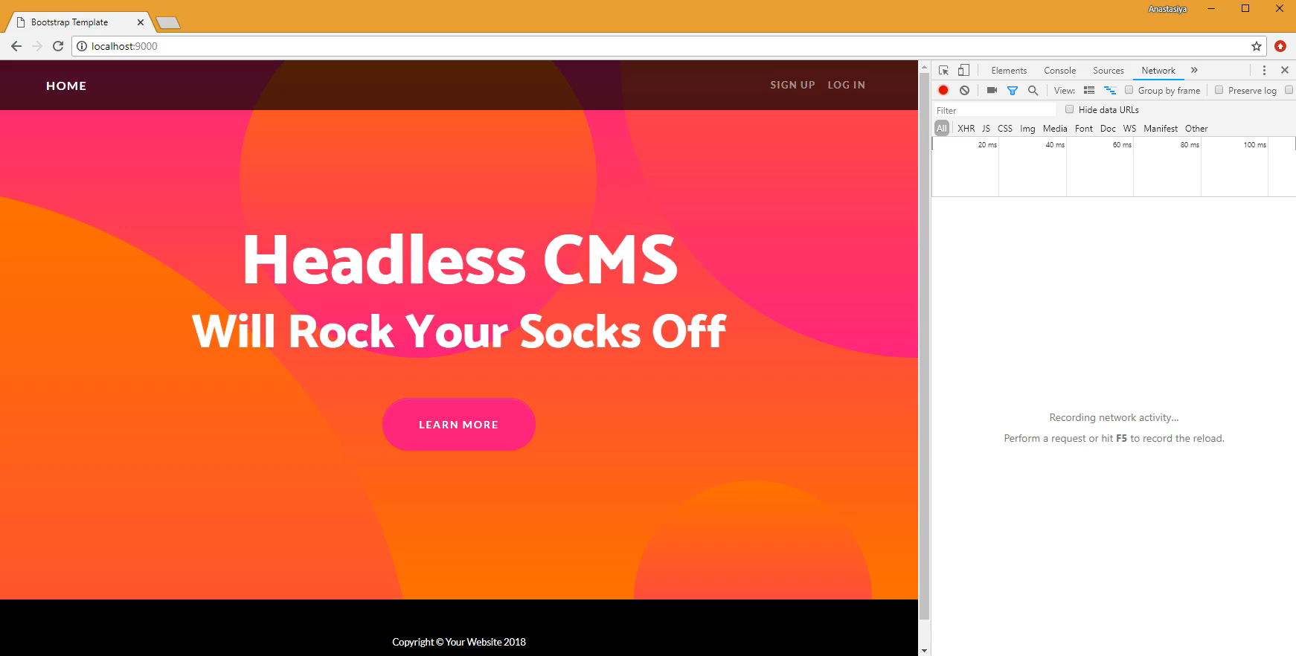
Dev Server – Ajax?
@AnastasiyaFlynn
© 2001-2018 Sitecore Corporation A/S. All rights reserved. Sitecore® and Own the Experience® are registered trademarks of Sitecore Corporation A/S. All other brand and product names are the property of their respective owners.

Slide 34
TypeScript Helix – Best practice patterns
Server interaction
Encapsulate all Ajax functionality in an injectable helper
UI component classes
Accept server interaction helpers as parameters in constructors
Never hardcode server endpoints
Don’t talk to the server directly
@AnastasiyaFlynn
© 2001-2018 Sitecore Corporation A/S. All rights reserved. Sitecore® and Own the Experience® are registered trademarks of Sitecore Corporation A/S. All other brand and product names are the property of their respective owners.

Slide 35
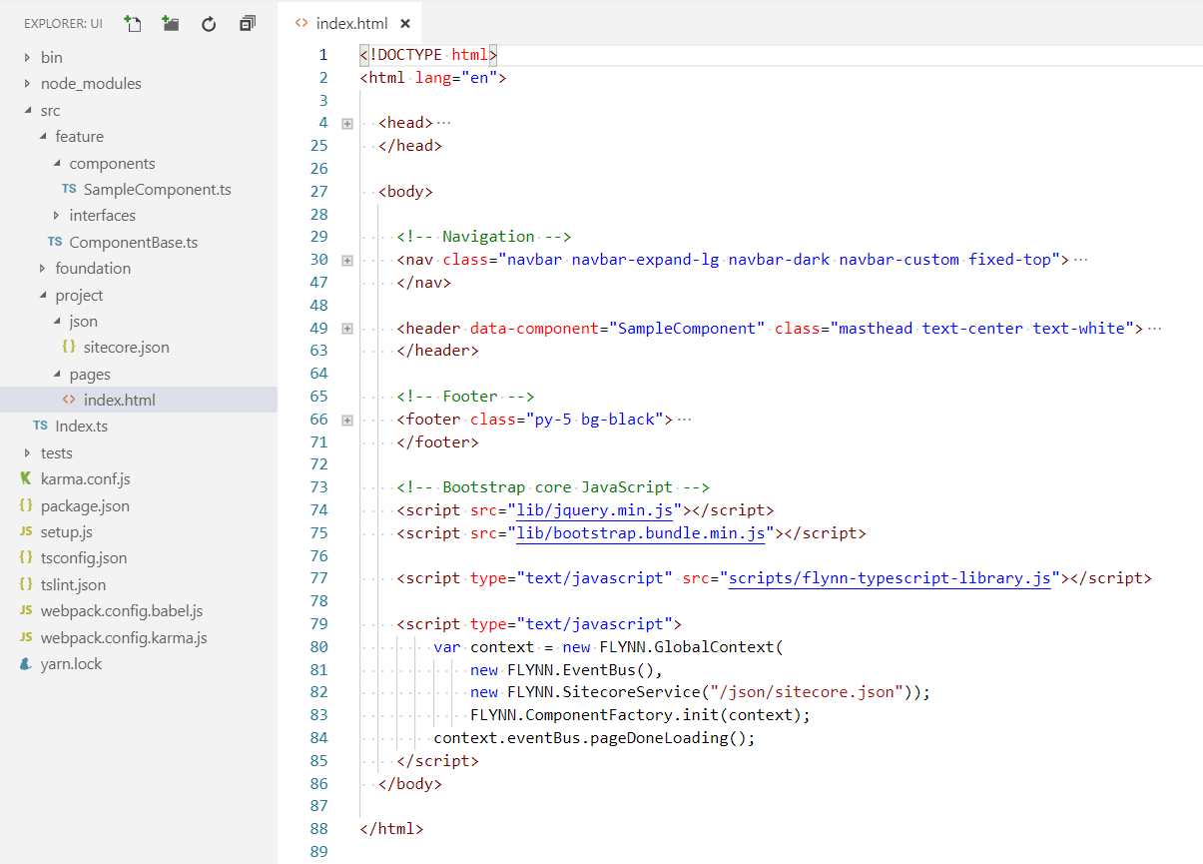
/src/project/pages/index.html
@AnastasiyaFlynn
© 2001-2018 Sitecore Corporation A/S. All rights reserved. Sitecore® and Own the Experience® are registered trademarks of Sitecore Corporation A/S. All other brand and product names are the property of their respective owners.

Slide 36
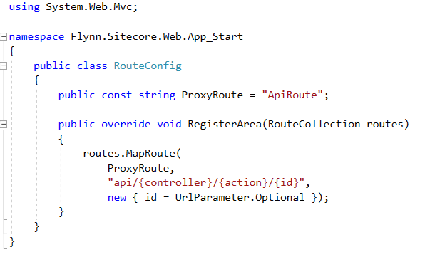
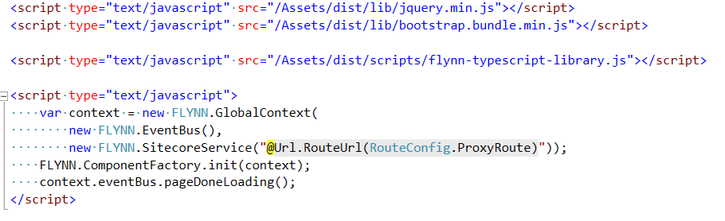
@AnastasiyaFlynn
© 2001-2018 Sitecore Corporation A/S. All rights reserved. Sitecore® and Own the Experience® are registered trademarks of Sitecore Corporation A/S. All other brand and product names are the property of their respective owners.

Slide 37
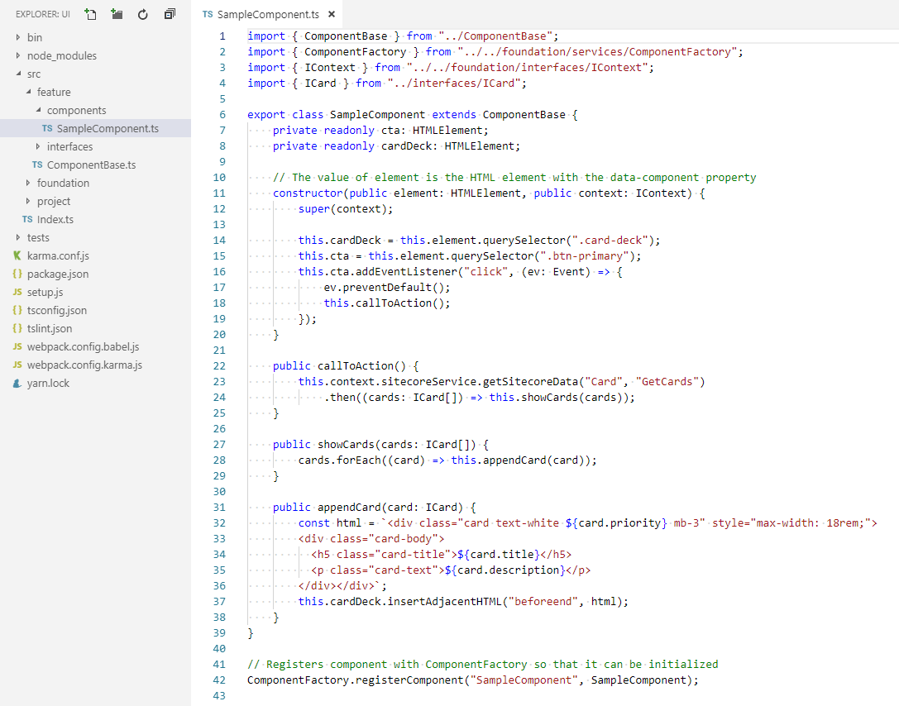
Headless CMS – Sample Component
@AnastasiyaFlynn
© 2001-2018 Sitecore Corporation A/S. All rights reserved. Sitecore® and Own the Experience® are registered trademarks of Sitecore Corporation A/S. All other brand and product names are the property of their respective owners.

Slide 38

Testing
Unit test JavaScript with Jasmine and Karma
Setup
Testing
Development
@AnastasiyaFlynn

Slide 39
Why Unit Test JavaScript?
Unit tests are valuable because they:
Document the code
Shows how code is expected to work
Shows how code is expected to be used
Enforce good class design
Classes have to be broken up into granular functions (units)
Classes have to use dependency injection
Enforce good Sitecore component design
UI component classes must be autonomous and self-contained
@AnastasiyaFlynn
© 2001-2018 Sitecore Corporation A/S. All rights reserved. Sitecore® and Own the Experience® are registered trademarks of Sitecore Corporation A/S. All other brand and product names are the property of their respective owners.

Slide 40
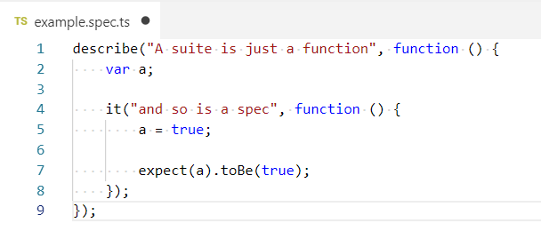
Jasmine - Setup
https://jasmine.github.io
> yarn add jasmine --dev
> yarn add jasmine-core --dev
> yarn add @types/jasmine --dev
@AnastasiyaFlynn
© 2001-2018 Sitecore Corporation A/S. All rights reserved. Sitecore® and Own the Experience® are registered trademarks of Sitecore Corporation A/S. All other brand and product names are the property of their respective owners.

Slide 41
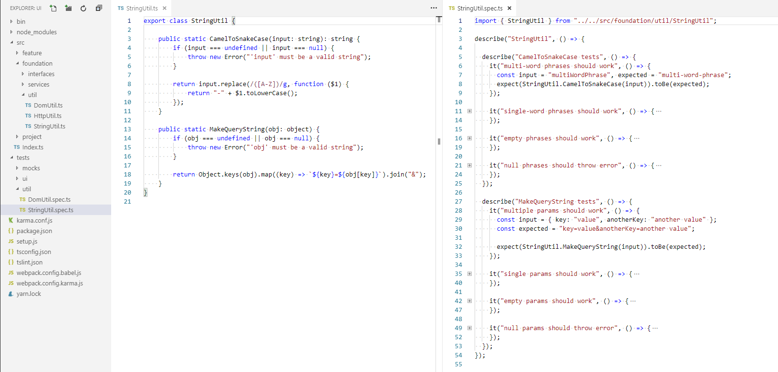
Jasmine - Implementation
@AnastasiyaFlynn
© 2001-2018 Sitecore Corporation A/S. All rights reserved. Sitecore® and Own the Experience® are registered trademarks of Sitecore Corporation A/S. All other brand and product names are the property of their respective owners.

Slide 42
TypeScript Helix – Best practice patterns (continued)
Server interaction
Encapsulate all Ajax functionality in an injectable helper
UI component classes
Accept server interaction helpers as parameters in constructors
Never hardcode server endpoints
Don’t talk to the server directly
Accept interface injection, not concrete classes
@AnastasiyaFlynn
© 2001-2018 Sitecore Corporation A/S. All rights reserved. Sitecore® and Own the Experience® are registered trademarks of Sitecore Corporation A/S. All other brand and product names are the property of their respective owners.

Slide 43
Unit Testing UI Components – Sample Component
@AnastasiyaFlynn
© 2001-2018 Sitecore Corporation A/S. All rights reserved. Sitecore® and Own the Experience® are registered trademarks of Sitecore Corporation A/S. All other brand and product names are the property of their respective owners.

Slide 44
TypeScript Helix – Best practice patterns (continued)
Server interaction
Encapsulate all Ajax functionality in an injectable helper
UI component classes
Accept server interaction helpers as parameters in constructors
Never hardcode server endpoints
Don’t talk to the server directly
Accept a DOM element in the constructor
Scope all actions to it’s DOM element
Accept interface injection, not concrete classes
@AnastasiyaFlynn
© 2001-2018 Sitecore Corporation A/S. All rights reserved. Sitecore® and Own the Experience® are registered trademarks of Sitecore Corporation A/S. All other brand and product names are the property of their respective owners.

Slide 45
Unit Testing UI Components – Sample Component
@AnastasiyaFlynn
© 2001-2018 Sitecore Corporation A/S. All rights reserved. Sitecore® and Own the Experience® are registered trademarks of Sitecore Corporation A/S. All other brand and product names are the property of their respective owners.

Slide 46
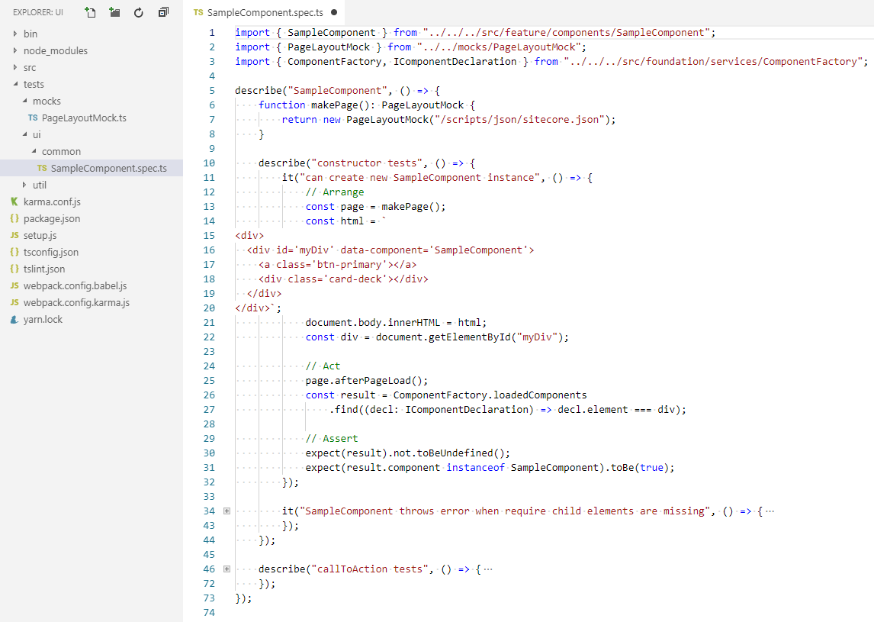
@AnastasiyaFlynn
© 2001-2018 Sitecore Corporation A/S. All rights reserved. Sitecore® and Own the Experience® are registered trademarks of Sitecore Corporation A/S. All other brand and product names are the property of their respective owners.

Slide 47
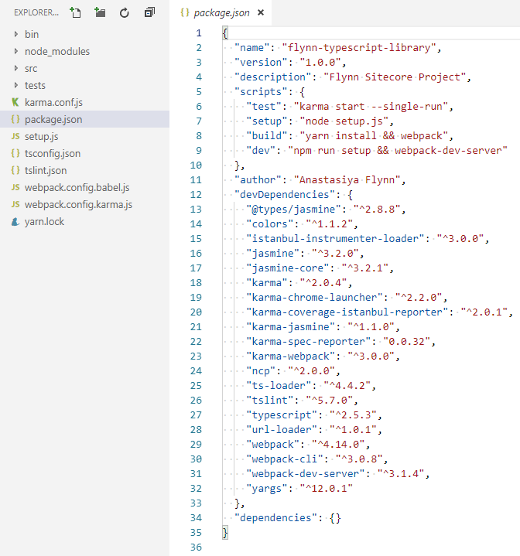
Karma - Setup
/package.json
http://karma-runner.github.io
> yarn add karma --dev
> yarn add karma-jasmine -- dev
> yarn add karma-chrome-launcher --dev
> yarn add karma-coverage-istanbul-reporter --dev
> yarn add karma-spec-reporter --dev
> yarn add karma-webpack --dev
@AnastasiyaFlynn
© 2001-2018 Sitecore Corporation A/S. All rights reserved. Sitecore® and Own the Experience® are registered trademarks of Sitecore Corporation A/S. All other brand and product names are the property of their respective owners.

Slide 48
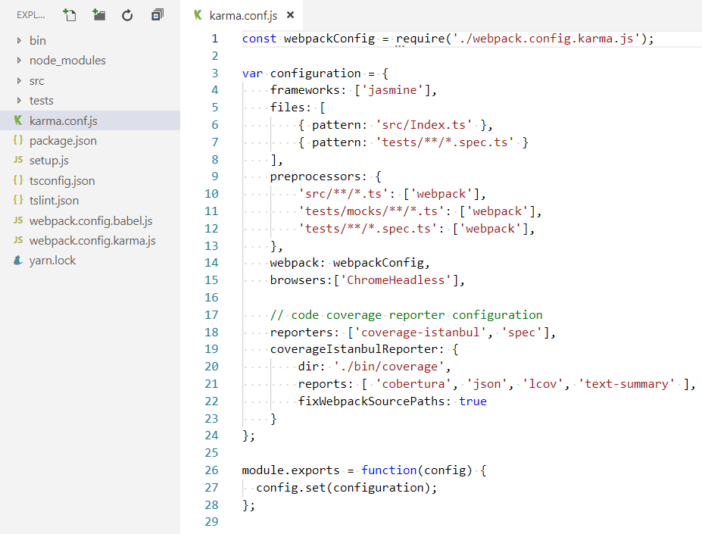
/karma.conf.js
@AnastasiyaFlynn
© 2001-2018 Sitecore Corporation A/S. All rights reserved. Sitecore® and Own the Experience® are registered trademarks of Sitecore Corporation A/S. All other brand and product names are the property of their respective owners.

Slide 49
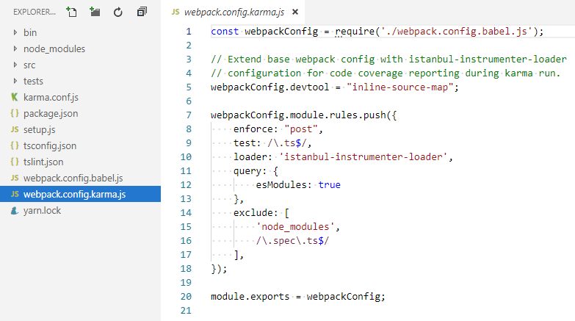
/webpack.config.karma.js
@AnastasiyaFlynn
© 2001-2018 Sitecore Corporation A/S. All rights reserved. Sitecore® and Own the Experience® are registered trademarks of Sitecore Corporation A/S. All other brand and product names are the property of their respective owners.

Slide 50
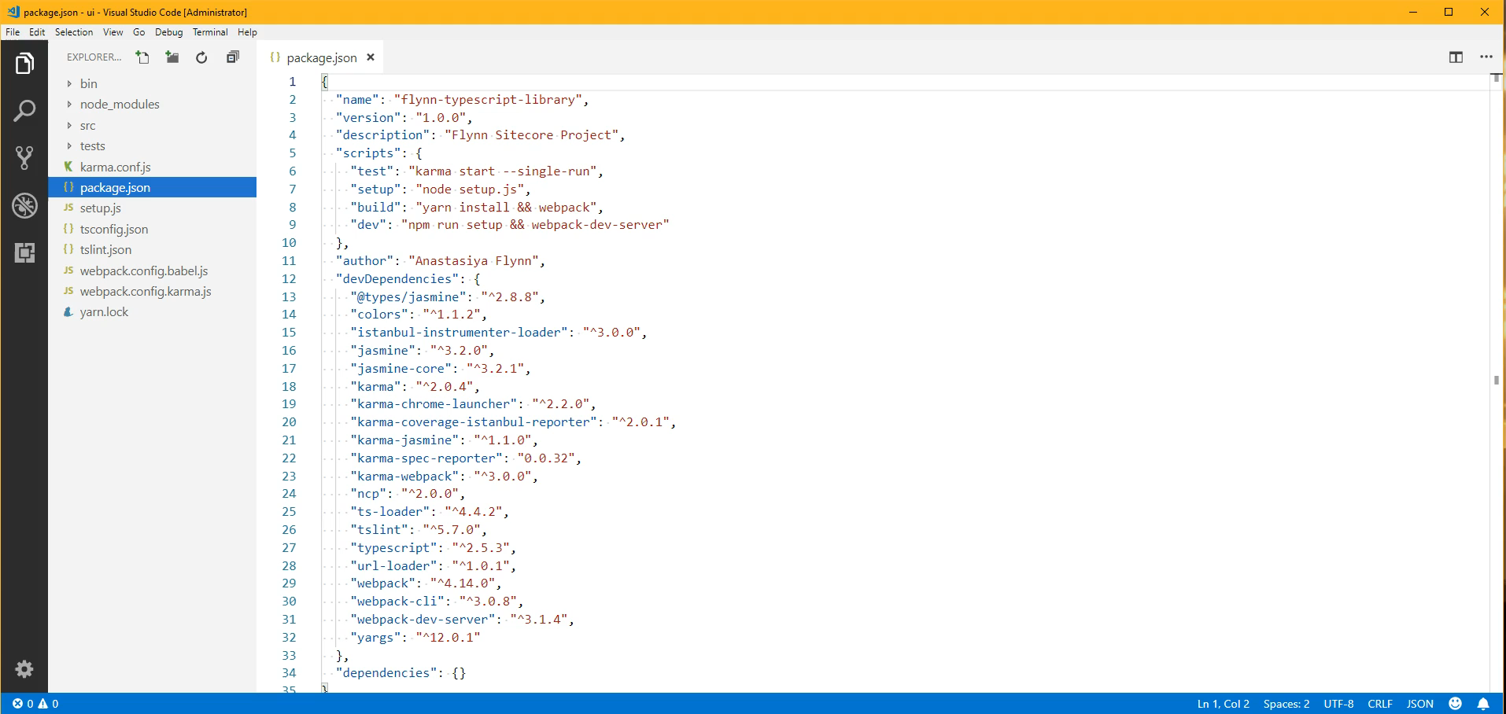
Jasmine/Karma – Demo
@AnastasiyaFlynn
© 2001-2018 Sitecore Corporation A/S. All rights reserved. Sitecore® and Own the Experience® are registered trademarks of Sitecore Corporation A/S. All other brand and product names are the property of their respective owners.

Slide 51
Get the code
https://bitbucket.org/anastasiya29/yeoman-sitecore-generator
@AnastasiyaFlynn

Slide 52

Let’s continue the conversation on Twitter @AnastasiyaFlynn

